Slide 1
Business case Tech team
Btc PREDICTIVE
MODEL
EMMANOUIL IERONYMAKIS

Slide 2
EXECUTIVE SUMMARY
By building a new predictive risk model for BTC,
we expect to be able to identify BCT price
behavior at least 25% more accurate in
comparison with our calculations today.
Suggested languages for the model is Python and
considering other data points impacting the
BTC behavior.
This allows us to help our current clients to
maximize their profits and at the same time
to attract new investors.

Slide 3
PROBLEM STATEMENT
Currently the BTC risk advice is solely based on a limited data base of historical data.
From 2015-2022 price of BTC is heavily fluctuating.
Currently is challenging to identify the financial risks that our clients face when invest in BTC.
We don’t have a suggested action plan for our clients to decrease risk factors.
Our existing stock models, are not compatible as BTC has proven to behave differently.

Slide 4
BTC DATASET
Our dataset provides us accurate data for BTC.
Monthly open and close price
Monthly high and low price
Monthly volume (sum of all BTC being bought and sold)
Unfortunately, those data are not enough for our model, as the price of BTC affects by multiple factors.
You can find more details for our dataset in the excel file “BTC-USD_Database”

Slide 5
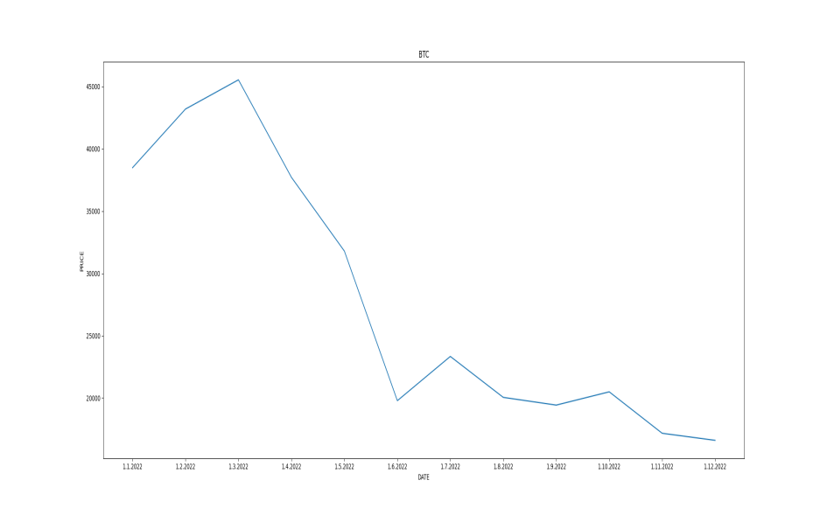
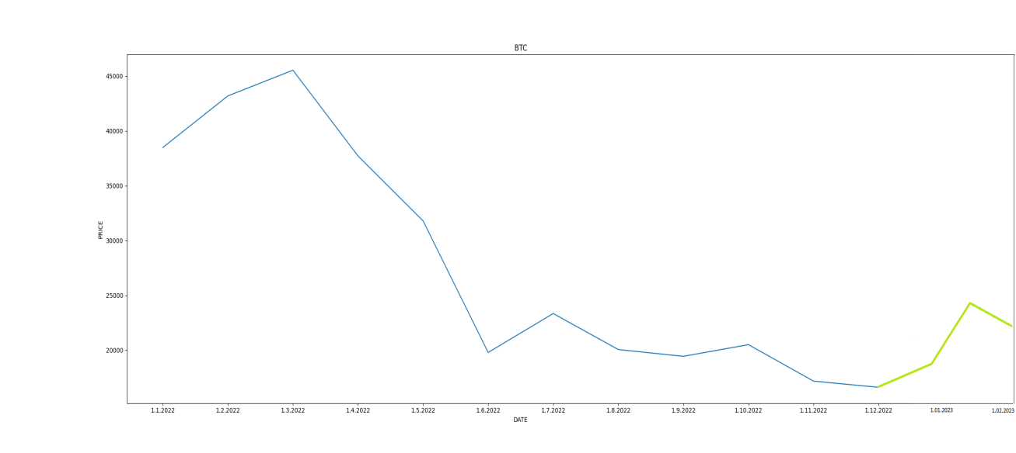
SOLUTION PROPOSAL
Create a new predictive machine learning model that analysis multiple BTC data to predict the future price more accurately.
?

Slide 6
DATA THAT WE ARE GONNA NEED IN OUR MODEL
Monthly BTC opening-closing price.
BTC volatility.
Cryptocurrency market general monthly picture.
Indicators (RSI, Moving averages, VWAP,VPRV Imbalances).
Technical analysis price patterns (triangles, bull-bear flags, engulfing patterns, price action).
Fundamental analysis data (BTC active wallets, BTC news, BTC users, BTC short and long investors).

Slide 7
BENEFITS
Increased certainty that we have a more reliable tool for our investments.
More BTC clients as BTC is the perfect asset for our aggressive portfolios.
More BTC control as the probability to predict the direction of BTC wrong is going to be less.
Win rate in going to increase. Expected ROI can be more than 900%, as we acquire at least 10 new clients and at the same time manage to increase profits for existing clients.
Improved company systems compatible to all markets

Slide 8
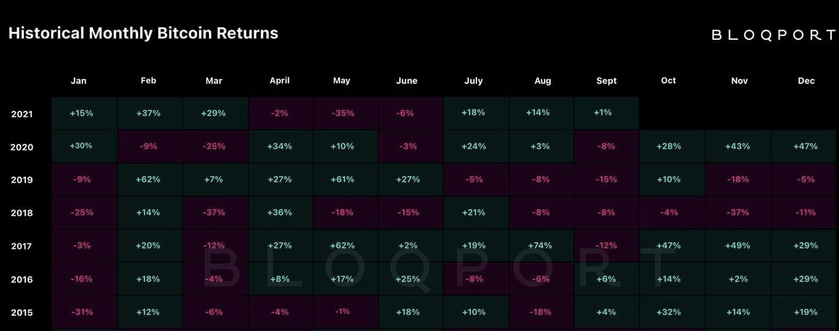
BTC ROI
Based on our dataset, we can see that annual ROI of BTC in future can be more than 100%.

Slide 9
TIMELINE AND COSTS
6 months in total.
3 months to build and develop our model.
2 months of back testing our model in the market.
1 month to collect our data and improve possible errors.
4 full time employes
2 senior developers.
1 senior data scientist.
1 senior trader.
Expected cost of this project:
Total $108.000
3(senior) x 6(months) x 5.000(avg) = 90.000$
1 (junior) x 6(months) x 3.000(avg) = 18.000$

Slide 10
CONCLUSION
A new predictive BTC model.
25% more accuracy.
More reliable company models.
More clients.
More profits.
Technical project summary:
6 moths.
4 FTE
Cost of ~110.000$

